Slide 1
Hands-on walk-thru of D3.js

Slide 2


Slide 3
Visualizing GDP and life expectancy
Inspired by Hans Rosling’s “Health and Wealth of Nations” visualization from gapminder.org
Notes:
Final for this: http://blockbuilder.org/loganwilliams/90b5ac0ede7349f83208136e2d5f5021

Slide 4
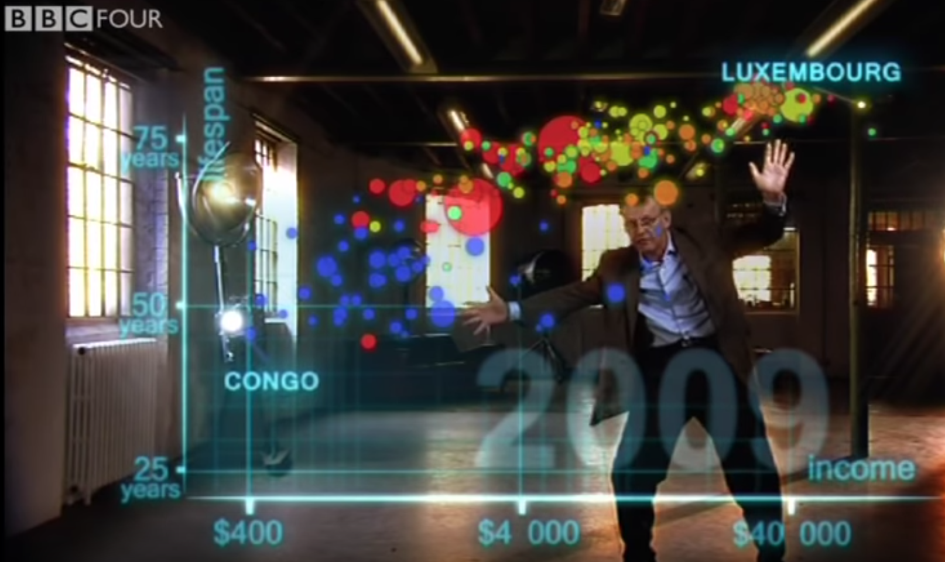
Hans Rosling videos:
On BBC’s “Joy of Stats”: http://sta.mn/y6r
2006 TED talk: http://sta.mn/shf

Slide 5
First, download some data:
http://sta.mn/yww
country,gdp,lifeexp,population,region,color,rgb,loggdp
Kuwait,64256.41951,68.35385246,1313738.049,Middle East & North Africa,green,[0 1 0],4.807916522
Luxembourg,36286.24377,72.92478689,375718.3115,Europe & Central Asia,orange,[1 .6 .3],4.559742014
United States,28990.59574,73.5852623,235012383.7,America,yellow,[1 1 0],4.46225714
Switzerland,27652.04918,75.87004918,6366298.164,Europe & Central Asia,orange,[1 .6 .3],4.441727321
Norway,26679.49623,76.09822951,4080763.541,Europe & Central Asia,orange,[1 .6 .3],4.426177625
Canada,23079.49098,75.245,24696114.8,America,yellow,[1 1 0],4.363226226
Denmark,21603.91131,74.56686885,5024245.492,Europe & Central Asia,orange,[1 .6 .3],4.334532386
Netherlands,21320.9518,75.85378689,13871609.03,Europe & Central Asia,orange,[1 .6 .3],4.328806588
Iceland,21246.22459,76.66583607,232060.2459,Europe & Central Asia,orange,[1 .6 .3],4.327281768
Germany,21237.21934,73.74055738,77965638.64,Europe & Central Asia,orange,[1 .6 .3],4.327097653
Sweden,21224.52197,76.44691803,8276185.197,Europe & Central Asia,orange,[1 .6 .3],4.326837918
Austria,21157.7241,73.50614754,7601006.967,Europe & Central Asia,orange,[1 .6 .3],4.32546895
Australia,20683.0559,75.04357377,15072167.13,East Asia & Pacific,red,[1 0 0],4.315614706
Belgium,20491.43049,73.90511475,9770283.508,Europe & Central Asia,orange,[1 .6 .3],4.311572277
Saudi Arabia,20235.01885,59.8745082,12321730.79,Middle East & North Africa,green,[0 1 0],4.306103613
United Kingdom,19971.35426,74.37083607,56300022.2,Europe & Central Asia,orange,[1 .6 .3],4.300407515
France,19861.43262,74.70485246,53447020.95,Europe & Central Asia,orange,[1 .6 .3],4.298010571
Notes:
https://gist.githubusercontent.com/almccon/e47e8bab24d66e198b1737005664df26/raw/5e7e4fbcaf986482aea142414f84b5046808977e/gapminder_avg.csv

Slide 6
Start with a fresh block
http://blockbuilder.org
(You will need to log in with your github account)
Notes:
Intro to Javascript, variables and functions.

Slide 7
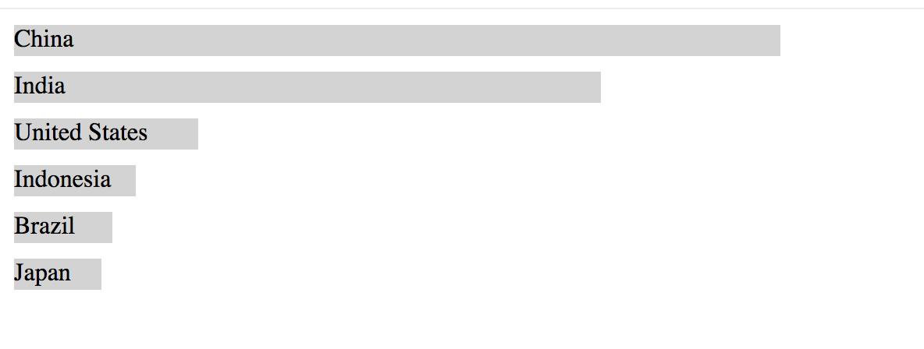
Data binding with D3
http://sta.mn/jb4
We’ll start by binding to HTML DOM elements like divs

Slide 8
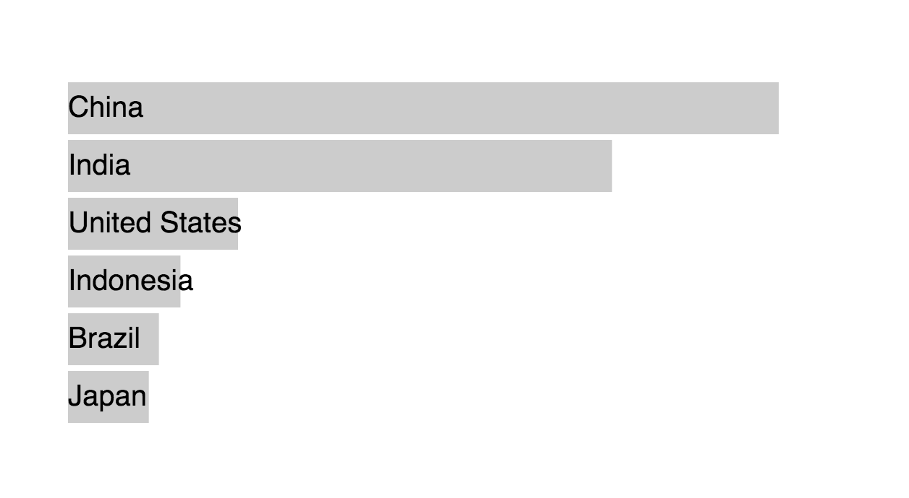
Data binding with D3
now with SVG
http://sta.mn/j9p
(looks a bit different)

Slide 9
Using D3 scales
http://sta.mn/fg2
(looks the same, actually, but the code is more reusable)

Slide 10
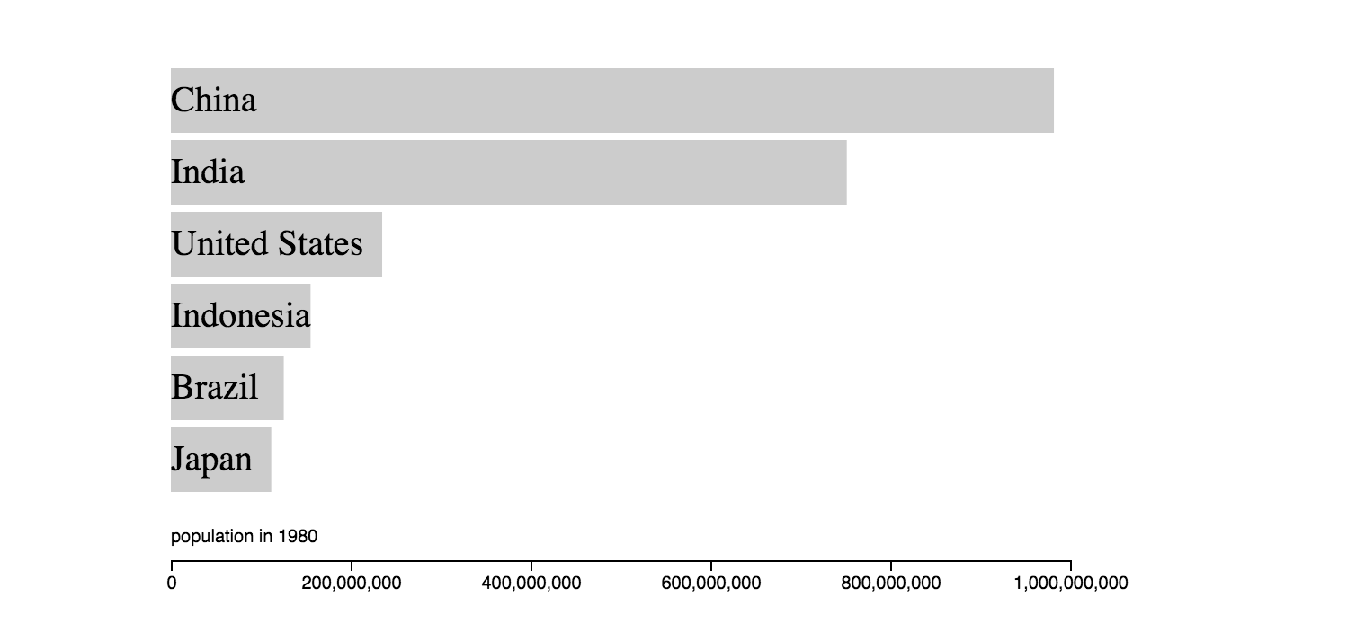
Adding D3 axes
http://sta.mn/wcm

Slide 11
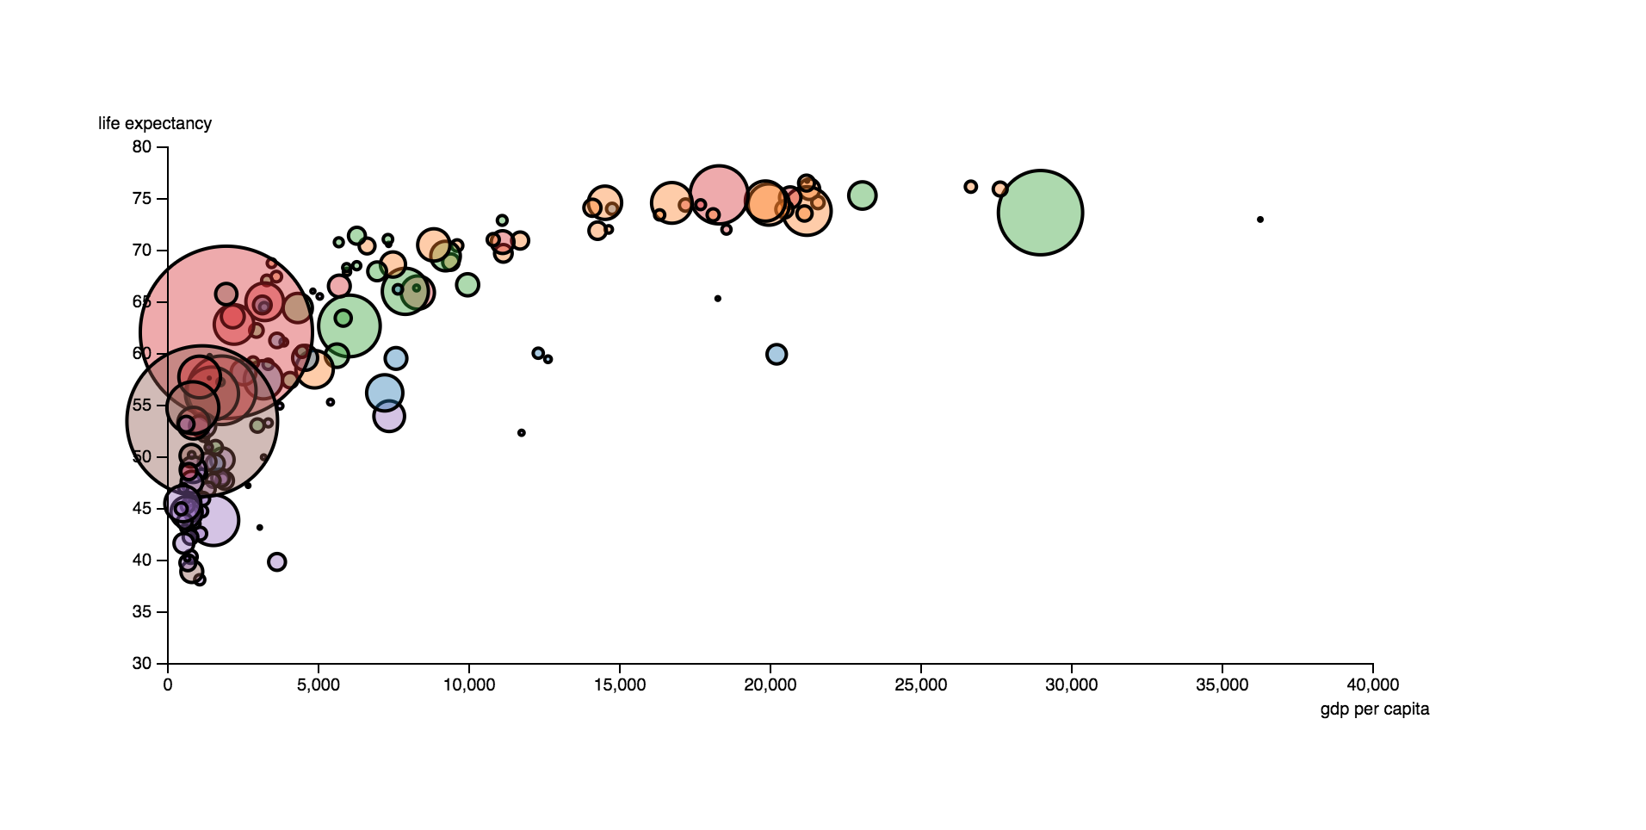
Full scatterplot version
http://sta.mn/45c

Slide 12
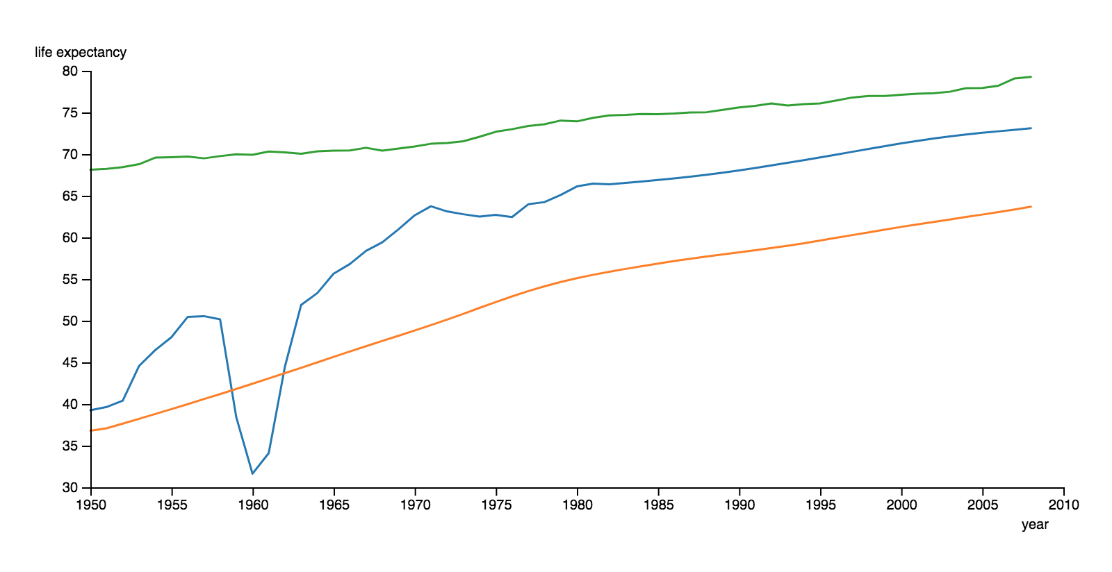
Line chart version
http://sta.mn/wys
Need to download a different dataset: http://sta.mn/nwk

Slide 13
Intermediate D3.js:
“enter, update, exit”:
The general update pattern
https://bl.ocks.org/mbostock/3808218
https://bl.ocks.org/mbostock/3808221
https://bl.ocks.org/mbostock/3808234

Slide 14


Slide 15
The general update pattern
Enter
Exit
Update
Merge

Slide 16
Just bought 5 apples.

Slide 17
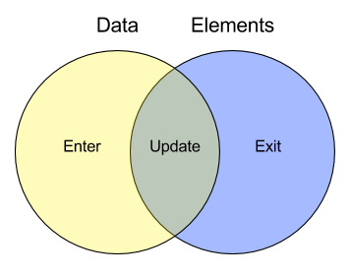
D3 Data Join
Diagram from https://www.amphinicy.com/blog/view/manipulating_svg_using_d3js_library/ By Antonio Grudiček

Slide 18
D3 Data Join
Diagram from https://www.amphinicy.com/blog/view/manipulating_svg_using_d3js_library/ By Antonio Grudiček

Slide 19
The general update pattern
Enter
Exit
Update
Merge

Slide 20
Just ate an apple.
“An apple a day keeps the doctor away”

Slide 21
D3 Data Join
Diagram from https://www.amphinicy.com/blog/view/manipulating_svg_using_d3js_library/ By Antonio Grudiček

Slide 22
The general update pattern
Enter
Exit
Update
Merge

Slide 23
Just replaced an apple with a lemon.

Slide 24
D3 Data Join
Diagram from https://www.amphinicy.com/blog/view/manipulating_svg_using_d3js_library/ By Antonio Grudiček

Slide 25
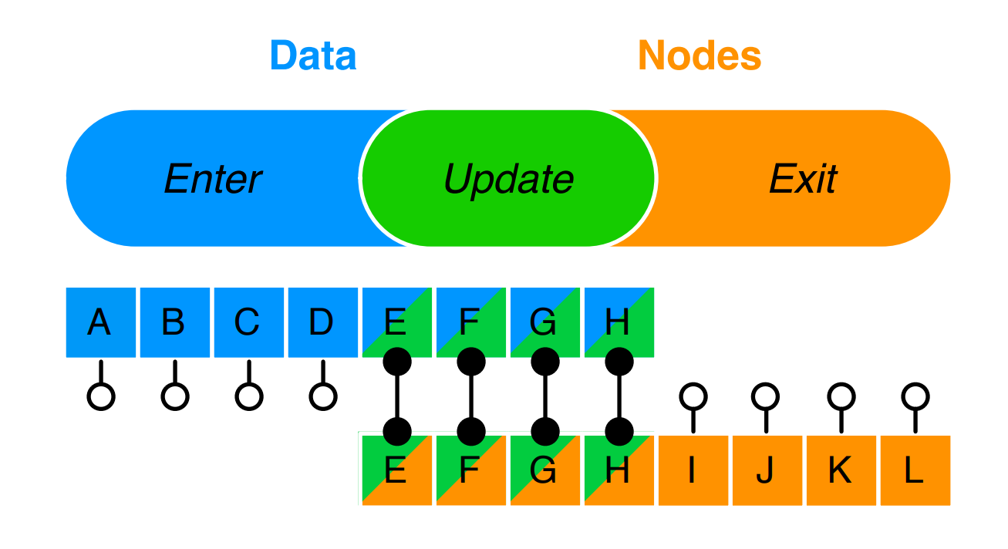
Diagram from the 2011 paper on D3 by Mike Bostock, Vadim Ogievetsky and Jeffrey Heer http://vis.stanford.edu/files/2011-D3-InfoVis.pdf

Slide 26
The general update pattern
Enter
Exit
Update
Merge

Slide 27
Merged Enter & Update selection
Diagram from the 2011 paper on D3 by Mike Bostock, Vadim Ogievetsky and Jeffrey Heer http://vis.stanford.edu/files/2011-D3-InfoVis.pdf

Slide 28
D3 Data Join
Merged Enter & Update selection
Diagram from https://www.amphinicy.com/blog/view/manipulating_svg_using_d3js_library/ By Antonio Grudiček

